Slide 1
Finance, Savings and Investment
Syed A. Mamun, PhD, FCMA
Professor of Finance
Department of ESS
BRAC University

Slide 2
Scope of the Lesson
Financial Institutions and Financial Markets
Loanable Funds market
Government in the Loanable Funds Market

Slide 3

Financial Institutions and Financial Markets

Slide 4

What is Finance?
Finance studies how households, firms and governments obtain funds and use those funds efficiently.
Finance answers three important questions:
  Where does money come from?
  Where does money go?
  How are financial risks managed?

Slide 5
Finance vs Money
Finance | Money
Allocation of financial resources | Medium of exchange
Investment decisions | Used to buy goods
Borrowing and lending | Means of payment
Risk management | Store of value

Slide 6
Physical Capital vs Financial Capital
Physical Capital | Financial Capital
Machines | Stocks
Buildings | Bonds
Equipment | Bank Deposits
Factories | Loans
Physical capital produces goods.
Financial capital provides funds to purchase physical capital.

Slide 7
Capital and Investment
Capital Amount changes due to
  Investment
  Depreciation
Gross Investment- total amount spend on new capital
Net Investment = Gross investment – Depreciation

Slide 8

Gross vs Net Investment
Gross Investment
  Total investment.
Net Investment
  $Net Investment=Gross Investment−Depreciation$
Example
Gross Investment = Tk. 600 million
Depreciation = Tk.150 million
Net Investment = Tk.450 million

Slide 9
Wealth and savings
Wealth is the value of all the things that people own
Savings is the amount of income after consumption and tax
  Savings = Income – Consumption - Tax
Wealth
  increases with Savings and Capital gain, and
  decreases with capital loss

Slide 10

Saving and Investment
Saving
Income not spent on consumption.
  $Saving=Income−Consumption$
Investment
Purchase of new capital goods.
Examples
  New factory
  Machinery
  Technology
  Warehouse
Investment does NOT include purchasing existing shares.

Slide 11
Financial System of Bangladesh
Banks & FIs
IC, MCFIs & MFIs
Surplus Side:
Households
Business Firms
Institutions
Government
Bond Market
Deficit Side:
Business Firms
Institutions
Households
Government
Stock Market
FX Market
Derivative Market
Regulators: Bangladesh Bank, BSEC, IDRA, MRA and MoF

Slide 12
Financial Markets
Loan Market
Bond Market
Stock Market

Slide 13

Loan Market
Borrowers obtain loans from banks.
Examples
Home loan
Business loan
Agricultural loan
Characteristics
Fixed repayment
Interest payments
Bank is intermediary

Slide 14

Bond Market
A promise to repay money with interest.
Borrowers
  Government
  Corporations
Investors earn
  Interest
  Principal repayment
Example
  Bangladesh Treasury Bond
  10-year 10% corporate bond issues by X Ltd.

Slide 15

Stock Market
Companies sell ownership.
Investors become shareholders.
Returns
  Dividend
  Capital gain
Examples
  Dhaka Stock Exchange (DSE)
  Chittagong Stock Exchange (CSE)

Slide 16
Financial Institutions
Commercial Banks
Islami Bank
BRAC Bank
Dutch-Bangla Bank
Investment Banks
Issue securities
Underwriting
Insurance Companies
Collect premiums
Invest funds
Mutual Funds
Pool investors' money
Mortgage Companies
Pension Funds
Invest retirement savings

Slide 17
Insolvency and Illiquidity
Net worth of a financial institution
  Difference between market of total assets (what it has lent) and the market value of its liabilities ( what is has borrowed)
  If net worth is positive, the institutions is called solvent
  If net worth is negative, it is called insolvent
A financial institution is illiquid if it has made long-term loans with short-term deposit or borrowed fund and is faced with the sudden demand to fund from depositors or lenders.
  A solvent financial institution can be illiquid as well.
Financial Institutions are responsible to minimize insolvency and illiquid risks
Regulators monitors these risks

Slide 18
Central Bank
A central bank is the main financial regulatory authority of a country.
Key functions of Central Bank
  Issuing Currency: Holds the exclusive legal right to print and distribute bank notes and coins.
  Monetary Policy: Controls interest rates and the money supply to keep prices stable and manage inflation.
  Banker to the Government: Manages government accounts, processes state payments, and helps handle public debt and bonds.
  Banker's Bank: Holds required financial reserves for commercial banks and handles interbank transfers and check clearing.
  Lender of Last Resort: Provides emergency cash loans to sound commercial banks facing sudden liquidity shortages to prevent a banking collapse.
  Foreign Exchange Manager: Maintains and regulates the nation's gold and foreign currency reserves to support exchange rate stability.
  Supervision and Regulation: Inspects commercial banks and financial markets to ensure the entire banking system stays safe and transparent.

Slide 19
Interest Rate and Financial Asset Prices
Financial Assets
  Stock
  Bonds
  Short-term securities
  Loans
Interest rate is the percentage of interests amount on the price of the financial asset.
Therefore,
  When assets prices rises, interest rate falls when other things remaining the same
  When assets price falls, the interest rate rises.

Slide 20
Loanable Funds Market
The loanable funds market is the market in which savers supply funds to borrowers who want to finance investment and other expenditures.
People and institutions with surplus funds lend → people and institutions needing funds borrow.
Sources of Loanable fund
  Household or organizational savings (S)
  Government Budget Surplus (T – G)
  Borrowing from foreign sources ( M- X)
The price paid for using loanable funds is the real interest rate.

Slide 21

Why Do We Need a Loanable Funds Market?
Consider a company that wants to construct a new factory.
The factory may require Tk. 500 million, but the company may not have Tk. 500 million in cash.
It can therefore:
borrow from a bank,
issue bonds,
obtain other forms of financing.
At the same time, households may have savings that they do not currently need for consumption.
Flow of funds
Household saving → Financial intermediaries/capital markets → Business investment

Slide 22

The Real Interest Rate
The real interest rate is the interest rate adjusted for inflation.
Approximately:
R ≈i−π
  where:
    r = real interest rate
    i = nominal interest rate
    π = inflation rate
Example
If Nominal interest rate = 12% and Inflation = 7%
Then, r≈12%−7%=5%
The real interest rate is important because borrowers and savers care about the purchasing power of funds.

Slide 23
Demand for Loanable Funds
The demand for loanable funds comes mainly from borrowers.
The most important component is investment demand by firms.
Businesses borrow to finance:
  new factories,
  machinery,
  technology,
  expansion,
  research and development,
  inventories.
Governments and households can also borrow.

Slide 24
Demand for Loanable Funds
The demand for loanable funds is generally negatively related to the real interest rate.
When real interest rate falls,
Borrowing becomes cheaper.
Therefore:
Borrowing ↑ → Investment ↑ → Quantity of loanable funds demanded ↑
When real interest rate rises,
Borrowing becomes more expensive.
Therefore:
Borrowing ↓ → Investment ↓ → Quantity of loanable funds demanded ↓

Slide 25

Marginal Benefit and Investment
A firm will borrow and invest when the expected return from investment is sufficiently high relative to the cost of borrowing.
Suppose a company is considering a machine costing Tk. 10 million.
  If the expected return is 15% and the real interest rate is 8%, the project may be attractive.
  But if the real interest rate rises to 18%, the project may no longer be profitable.
Therefore:
  Higher real interest rates discourage investment.

Slide 26

Supply of Loanable Funds
The supply of loanable funds comes primarily from saving.
Sources include:
Households
Households save part of their income.
Firms
Businesses may retain earnings and accumulate financial resources.
Governments
A government budget surplus can provide funds.
Foreign sector
Foreign saving can provide funds to a domestic economy.

Slide 27

Supply of Loanable Funds
The supply of loanable funds is generally positively related to the real interest rate.
When the real interest rate increases:
saving becomes more attractive,
the reward for postponing consumption increases,
households may save more.
Therefore:
r↑⇒QS​↑
When the real interest rate falls:
r↓⇒QS​↓

Slide 28

Other factors drive Supply of Loanable Fund
Disposable Income
Income – Net Taxes
Expected Future Income
Wealth
Default Risk

Slide 29
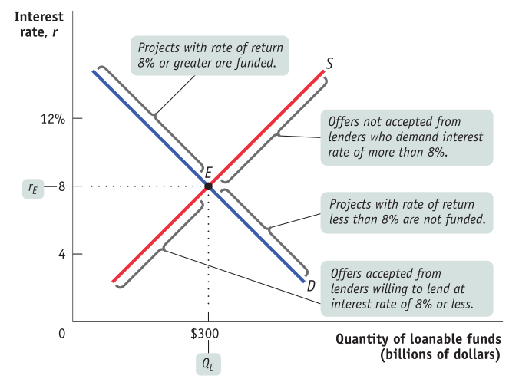
Equilibrium in the Loanable Funds Market

Slide 30
Changes in Demand of Loanable fund
A change in demand means the entire demand curve shifts.
Demand curve shifts RIGHT → Increase in demand
Suppose Bangladeshi firms expect strong economic growth and decide to build more factories. They need more financing, so demand for loanable funds increases. This tends to push the real interest rate upward.
Factor | Effect on Demand
Increase in expected profit | Demand ↑
Increase in expected economic growth | Demand ↑
Increase in business investment opportunities | Demand ↑
Increase in government budget deficit | Demand ↑
Increase in expected inflation | Usually demand ↑
Increase in population/business activity | Demand ↑

Slide 31
Changes in Supply of Loanable fund
Factor | Effect on Supply
Increase in household saving | Supply ↑
Increase in disposable income | Supply ↑
Greater confidence in financial institutions | Supply ↑
Increase in foreign capital inflows | Supply ↑
Tax incentives for saving | Supply ↑
Improved financial markets | Supply ↑
A change in supply means the entire supply curve shifts.
Supply curve shifts RIGHT → Increase in supply
An increase in supply means lenders/savers are willing to provide more funds at every real interest rate.

Slide 32
Effect on equilibrium
S₀ → S₁ (right)
➡ Real interest rate decreases
➡ Quantity of loanable funds increases
Example:
If households in Bangladesh increase their savings and deposit more money in banks, banks have more funds available for lending. The supply of loanable funds increases, putting downward pressure on the real interest rate.

Slide 33
Impact of shift of demand and supply of loanable funds
Change | Curve | Real Interest Rate | Quantity of Funds
Demand ↑ | D → right | ↑ | ↑
Demand ↓ | D → left | ↓ | ↓
Supply ↑ | S → right | ↓ | ↑
Supply ↓ | S → left | ↑ | ↓

Slide 34
Government in the Loanable Funds Market

Slide 35
Role of Government in Loanable Fund
The loanable funds market explains how households, firms, governments, and financial institutions interact to determine the real interest rate and the quantity of funds borrowed and lent.
The government participates in the loanable funds market mainly when it has a budget deficit.
  Government budget deficit: Government spending > Tax revenue
  The government must borrow to finance the deficit.
  It does this by issuing government bonds/securities.
  This makes the government a borrower/demander of loanable funds.

Slide 36
Government Budget Surplus vs. Deficit
Government position | Effect in loanable funds market
Budget deficit | Government demands/borrows funds
Balanced budget | Little or no net government borrowing
Budget surplus | Government can save/lend funds

Slide 37
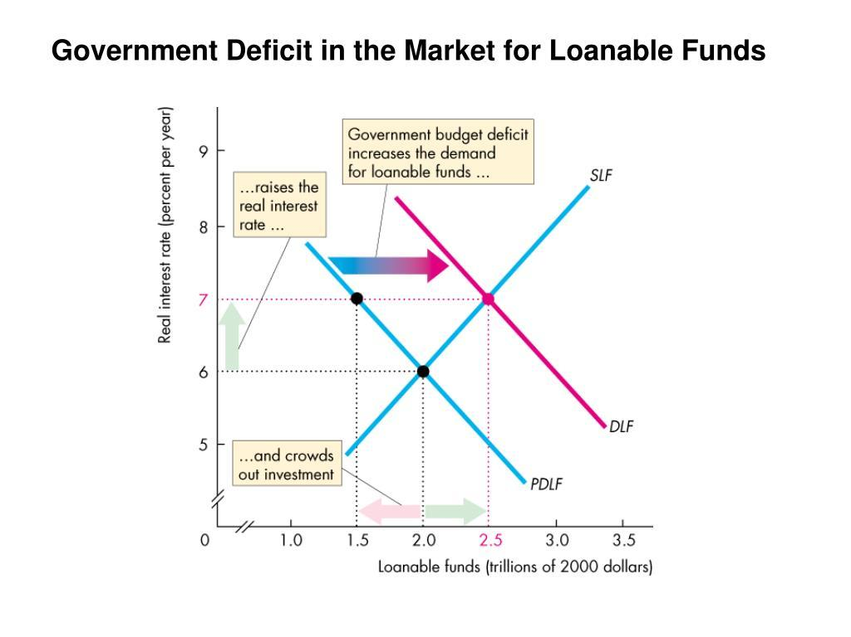
Effect of a Government Budget Deficit
Demand for loanable funds increases
This shifts the demand curve for loanable funds to the right.
Real interest rate rises
Quantity of loanable funds increases
Private borrowers face a higher cost of borrowing.

Slide 38
Crowding-Out Effect
One of the most important concepts is crowding out.
When the government borrows heavily:
Government borrowing ↑ → Interest rate ↑ → Private investment ↓
Higher interest rates make borrowing more expensive for businesses.

Slide 39
Government Budget Surplus
The opposite occurs when the government has a budget surplus.
Tax revenue > Government expenditure
The government has excess funds and can use them to reduce borrowing or increase national saving.
Therefore:
Budget surplus ↑ → National saving ↑ → Supply of loanable funds ↑ → Real interest rate ↓ → Private investment ↑
The supply curve of loanable funds shifts rightward.

Slide 40
Government and National Saving
National Saving=Private Saving+Government Saving
Government saving is:
Government Saving=T−G
where:
T = tax revenue
G = government expenditure
Therefore:
If T>G, government saving is positive → budget surplus.
If T<G, government saving is negative → budget deficit.

Slide 41
Ricardo–Barro Effect
The Ricardo–Barro effect, also called the Ricardian equivalence proposition, explains why a government budget deficit may not necessarily increase aggregate demand or interest rates.
Developed by economist David Ricardo and was later developed and popularized by Robert Barro.

Slide 42
Ricardo–Barro Effect
Suppose the government cuts taxes today but does not reduce government spending.
The government now has a budget deficit and must borrow.
Typical arguments are:
  Tax cut → Disposable income ↑ → Consumption ↑ → Saving ↓ → Interest rate ↑
However, Ricardo–Barro argues that households may realize:
  Today's tax cut means higher taxes in the future.
Therefore, instead of spending the additional income, households may save it to pay for future taxes.

Slide 43

Ricardo–Barro Effect
Government cuts taxes today
↓
Government budget deficit increases
↓
Government borrowing increases
↓
People expect higher future taxes
↓
Private saving increases
↓
National saving may remain unchanged
↓
Interest rate may remain unchanged
↓
Private investment may remain unchanged

Slide 44
Numerical Example
Government reduces taxes by Tk. 100 billion.
Government saving falls: 200−100=100
But households save the entire Tk. 100 billion tax reduction: 500+100=600
Therefore:
National Saving=600+100=700 billion
National saving remains unchanged.
Consequently, the loanable-funds supply curve does not shift, and the real interest rate need not rise.
Item | Before tax cut
Private saving | Tk. 500 billion
Government saving | Tk. 200 billion
National saving | Tk. 700 billion

